Slide 1

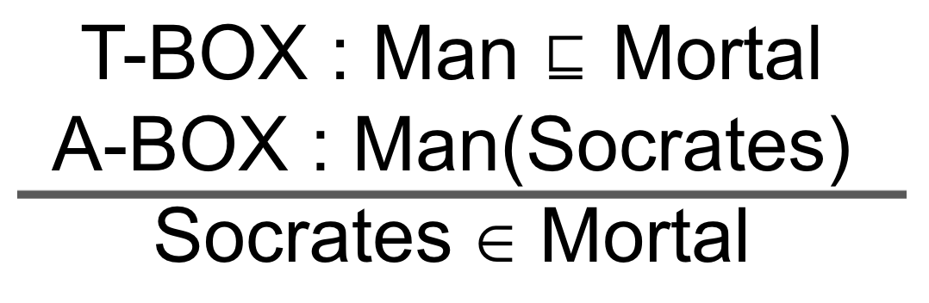
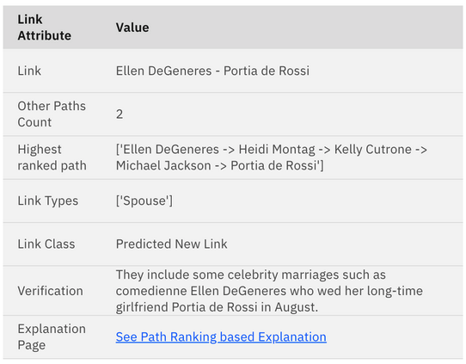
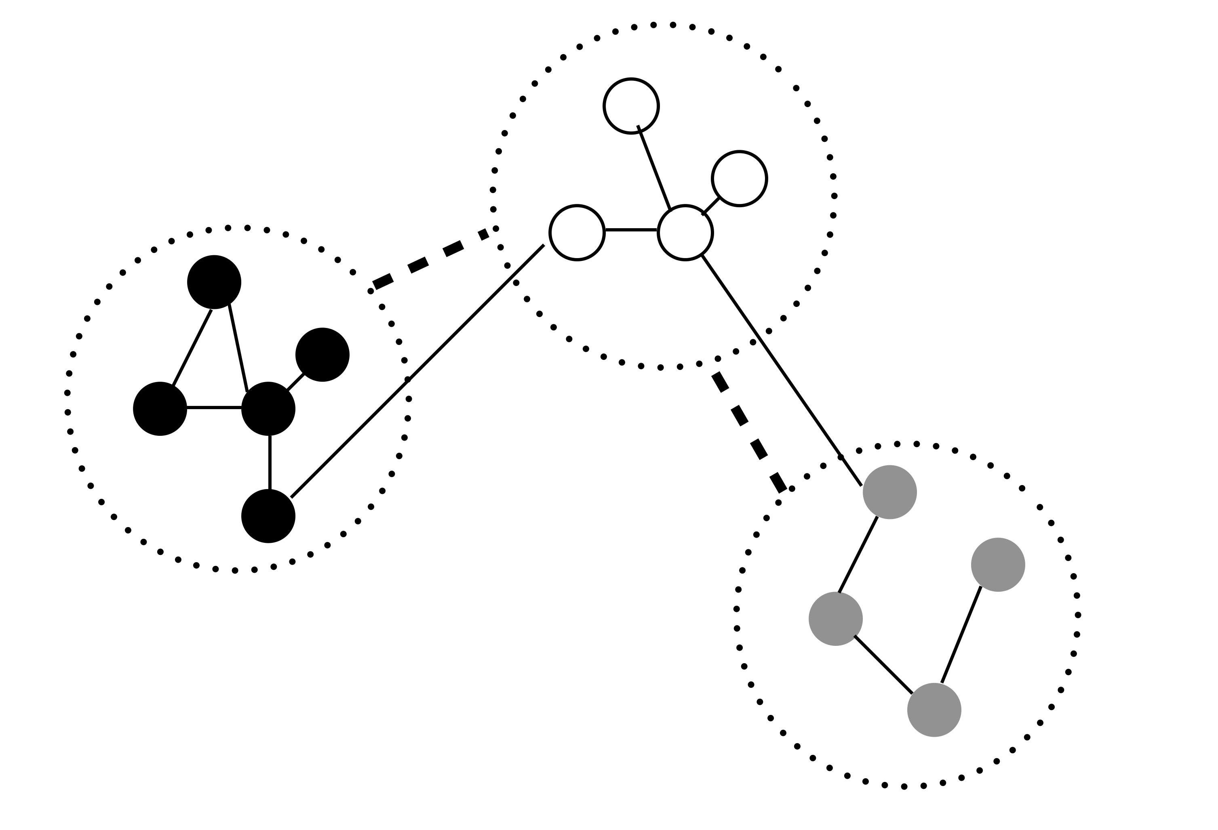
Towards Automated Evaluation of Explanations in Graph Neural Networks
Vanya BK,¹ Balaji Ganesan,² Aniket Saxena,³ Devbrat Sharma,⁴ Arvind Agarwal²
¹ IIT Madras, ² IBM Research, ³ IBM, ⁴ IBM Data and AI. bganesa1@in.ibm.com
ICML 2021 Workshop on Theoretic Foundation, Criticism, and Application Trend of Explainable AI
GNN Explanations are hard to understand. So, before we present model explanations to end users, it is desirable to automatically evaluate them.
The reason for using MLP is two-fold:
the parameters of MLP are shared by all edges of the input graphs and thus help in capturing the global view of the graph model;
approximation of derivatives of the learned function can be done by derivatives of MLPs.
However, these methods do not take into account the interactions among different edges and nodes. The explanation using these methods, may also result in disconnected nodes and edges, thereby become less intelligible to end users.
In contrast to perturbation-based methods, non-perturbation-based methods do not utilize MLP. However, such methods still need to be evaluated, preferably using automated evaluation techniques. Rather, these methods aim to consider different subgraphs of the input graph. The most recent subgraph-based approach is [2].
Neuro-Symbolic Reasoning
We propose that we can use reasoners typically used in semantic web and ontologies, to automatically evaluate the explanations from GNN explainability techniques, provided we're able to convert them into axioms.
In law courts, it is said that the best case from the point of view of prosecutors, is a strong circumstantial case. Circumstantial cases have a number of objectively provable facts. Likewise substantiating GNN model explanations with other systems, as shown below from [1], could be useful.
If "All men are mortal" is the universal truth, "Socrates is a man" is instance level assertion (perhaps from training data or another prediction) and the current GNN model prediction is "Socrates is mortal", then the GNN prediction can also be concluded using the modus ponens rule of inference.
Further, we can generate natural language explanations from description logic. If we have text from the corpus that are semantically similar-to natural language explanations, we have additional data points to substantiate the explanations.
In [3], we had used an information retrieval approach to get verification text that substantiates a predicted link.
Clustering as Explanation
References
Missing Global Structure Information
[1] Ganesan, B., Patel, H., and Mehta, S. Explainable link prediction for privacy-preserving contact tracing. SpicyFL Workshop. NeurIPS 2020. arXiv:2012.05516, 2020
[2] Yuan, H., Yu, H., Wang, J., Li, K., and Ji, S. On explainability of graph neural networks via subgraph explorations. arXiv preprint arXiv:2102.05152, 2021
[3] Ganesan, B., Mishra, G., Parkala, S., Singh, N. R., Patel, H., and Naganna, S. Link prediction using graph neural networks for master data management. arXiv preprintarXiv:2003.04732, 2020.
Recently, Multi-Layer Perceptrons (MLPs) have extensively been used as an explanation network in masking-based explanation methods to identify the edges which are affecting final predictions the most. We observe that further work in this direction may result in subgraph explanations that are more intelligible to end users.
In an industrial application, for explaining entity matching (using GNNs), we’re trying to show clusters (dotted circles) among node attribute values, to substantiate why two or several nodes (entities) might be matched.

